Slide 1

Healthcare Agent AI – Intelligent Personal Healthcare Assistant
An AI-Powered Personal Healthcare Assistant Built using Streamlit, Python, Supabase, and LLMs.
Name: Prince Rajendraprasad Yadav Class: Data Science And Artificial Intelligence
College: HVPS Ramniranjan Jhunjhunwala College
Course: Applied AI Internship – AICTE IBM SkillsBuild

Slide 2
The Challenge: Fragmented Healthcare Management
1
2
Scattered Health Data
Ignored Symptoms
Personal health information is often fragmented across various platforms, making comprehensive management nearly impossible.
Early symptoms are frequently overlooked or misunderstood, leading to delayed interventions and potential health complications.
3
4
Non-Compliance Issues
Limited Personalised Care
Patients struggle with medication schedules and appointment adherence, impacting treatment effectiveness.
Access to tailored, preventive healthcare advice is often restricted, preventing proactive health management.

Slide 3
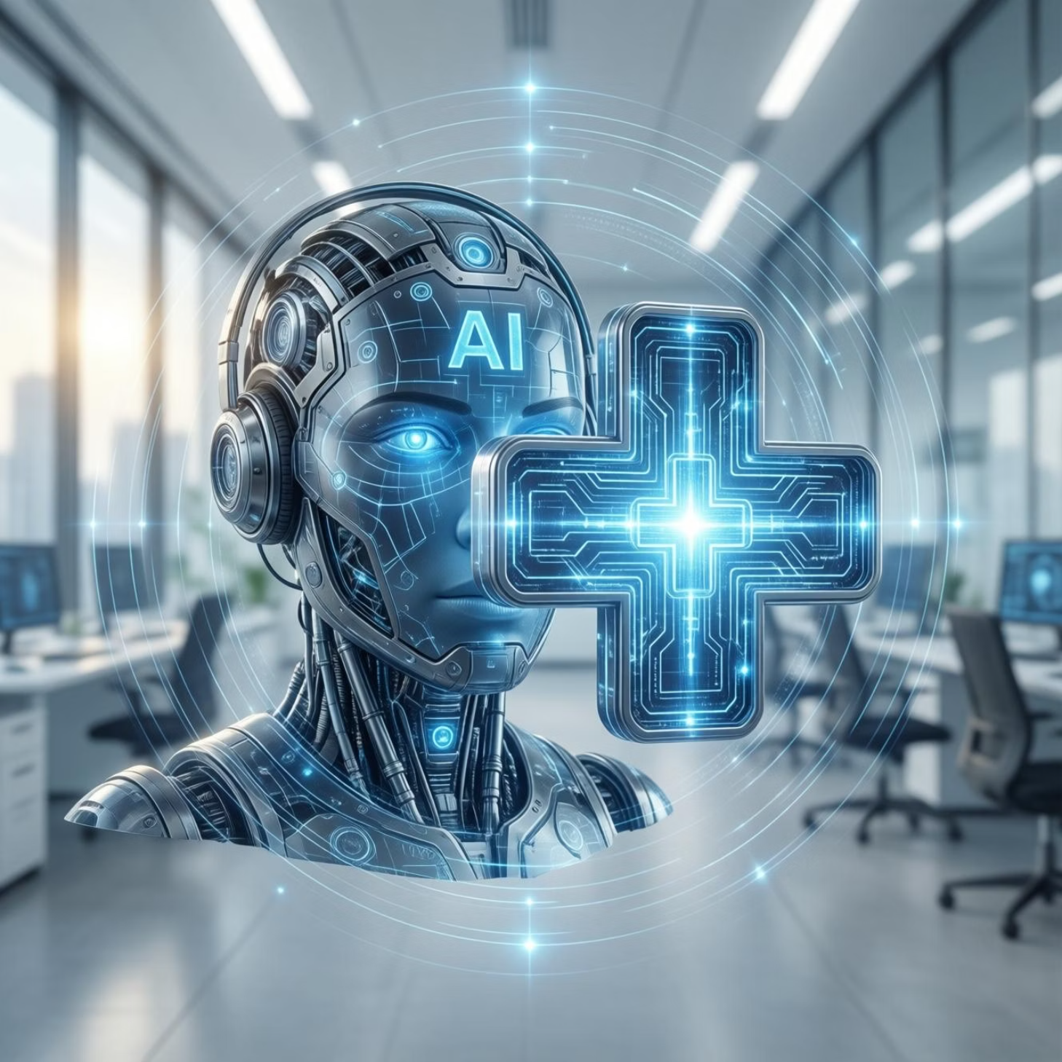
Our Solution: A Unified AI Healthcare Assistant
AI-Driven Integration
A central AI system harmonises all health data, providing a holistic view of user well-being.
Smart Reminders
Automated alerts and notifications ensure compliance with medication and appointment schedules.
Intelligent Analysis
Advanced AI capabilities interpret symptoms and offer actionable guidance for timely care.
Secure Cloud Storage
All personal health data is stored securely in the cloud, accessible anytime, anywhere.

Slide 4


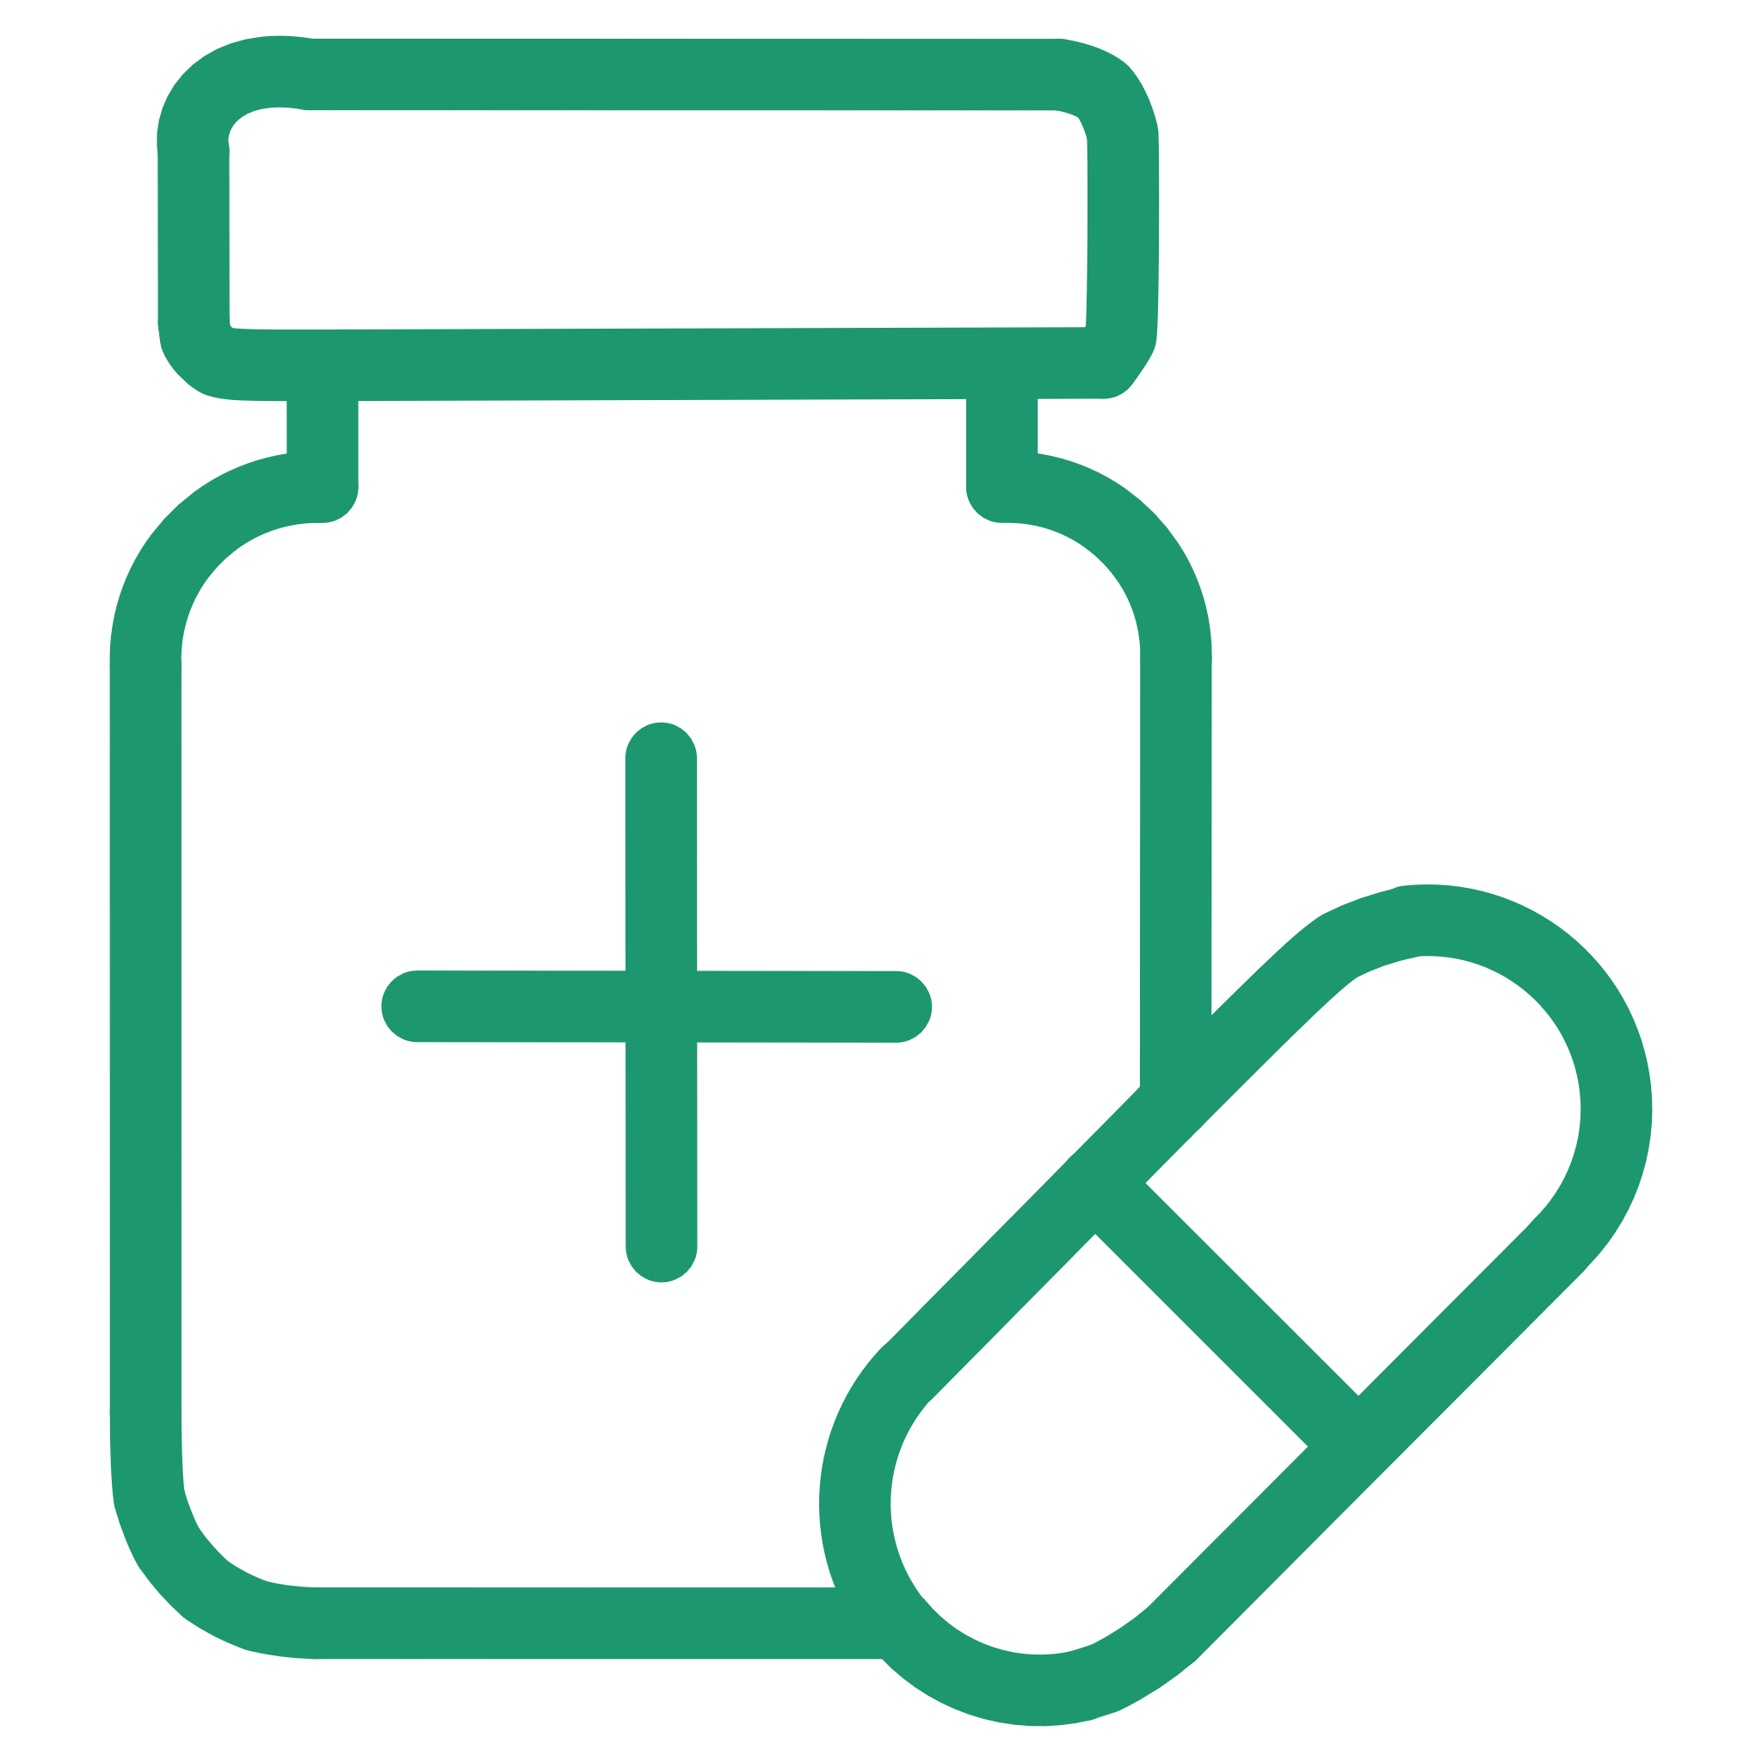


Key Features for Holistic Health Management
Secure Authentication
AI Symptom Checker
Medication Reminders
Robust user authentication and personalised profile management ensure data privacy.
An intelligent tool to help users understand their symptoms and potential health concerns.
Timely notifications via email help users stay on track with their medication regimens.
Health Vitals Tracking
Mental Health Support
Monitor key health metrics and calculate BMI for a comprehensive health overview.
Conversational AI provides empathetic support for mental well-being concerns.

Slide 5
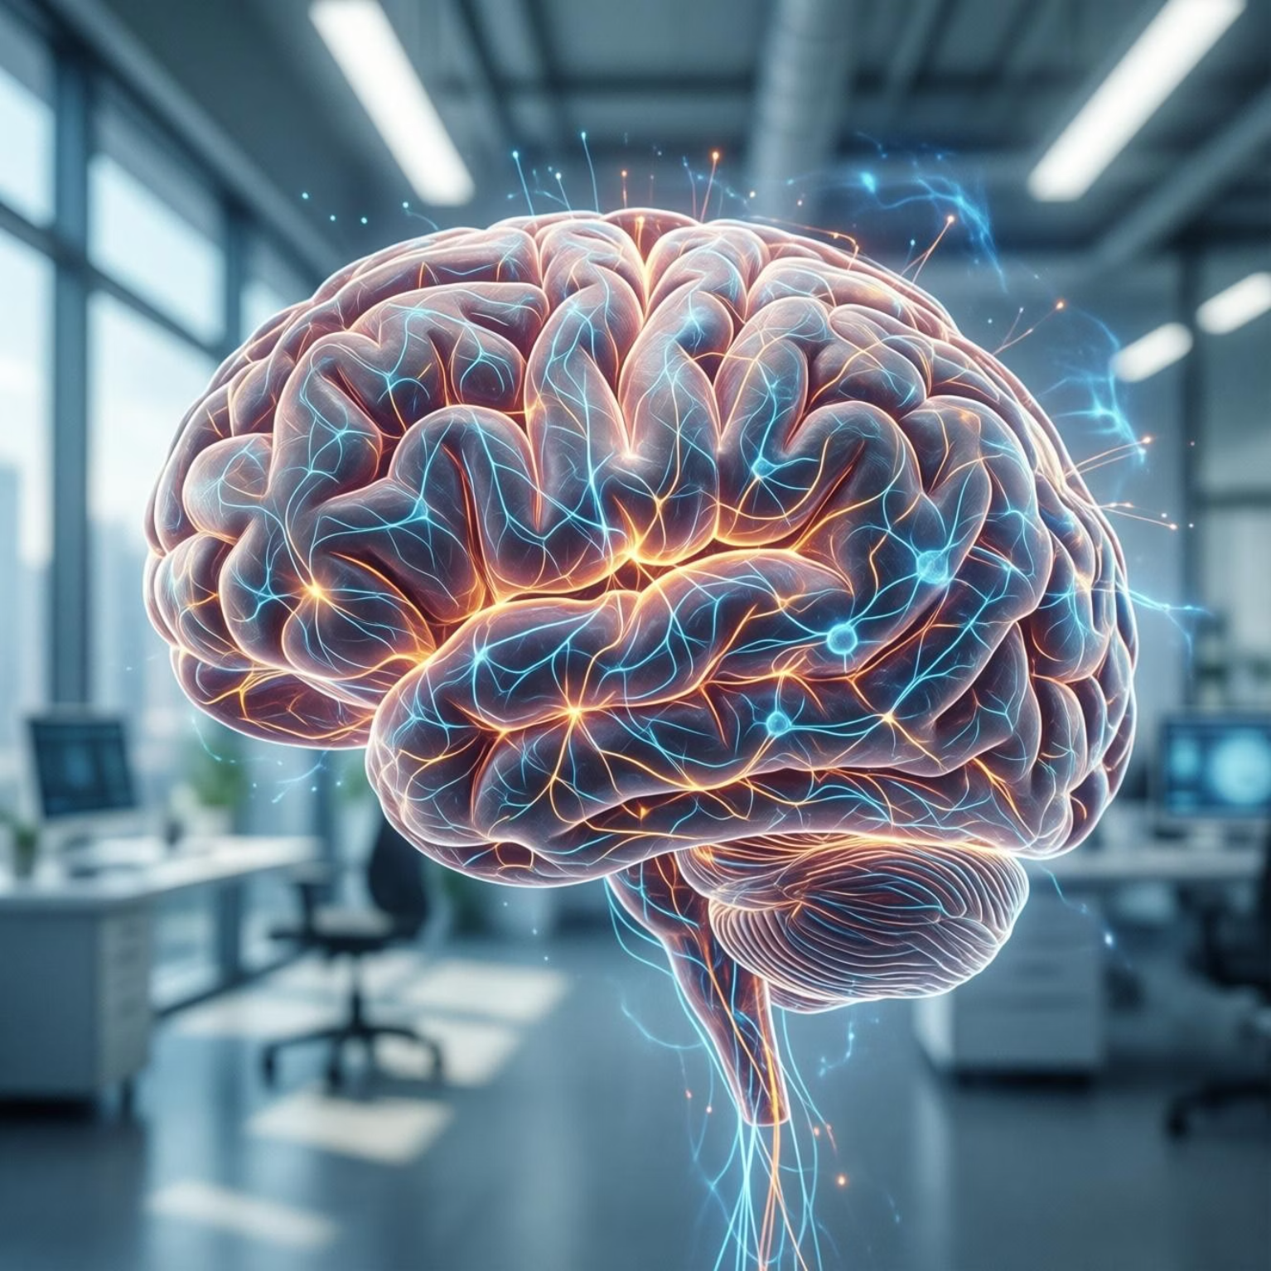
Advanced AI Capabilities at the Core
LangGraph & LLM-Based Symptom Analysis: Utilises advanced language models for accurate symptom assessment and potential diagnoses.
Personalised Health Recommendations: Tailors health advice based on individual data, promoting proactive wellness.
Mental Wellness Conversational AI: Offers supportive and understanding dialogue for emotional and psychological support.
Decision-Based Health Guidance: Provides clear, actionable steps for users based on their health profile and symptoms.

Slide 6
Robust Technology Stack
Frontend: Streamlit
1
Intuitive and user-friendly interface for seamless interaction.
Backend: Python
2
Powerful and flexible programming language for core logic and data processing.
Database: Supabase (PostgreSQL)
3
Secure and scalable relational database for health data storage.
AI Engine: LangGraph + LLM
4
Cutting-edge AI models for intelligent analysis and conversational capabilities.
Notifications: Relay / SMTP Email
5
Reliable system for delivering timely reminders and alerts.

Slide 7

System Architecture: Seamless Integration
Streamlit UI
Patient and clinician interface
Email Notifications
Backend Services
Healthcare App Architecture
Timely alerts and summaries
APIs for business logic
AI Modules
Supabase
Analytics and clinical insights
Auth and patient data storage
The architecture ensures a smooth flow of data and functionality, from user interaction to intelligent insights and timely alerts.

Slide 8
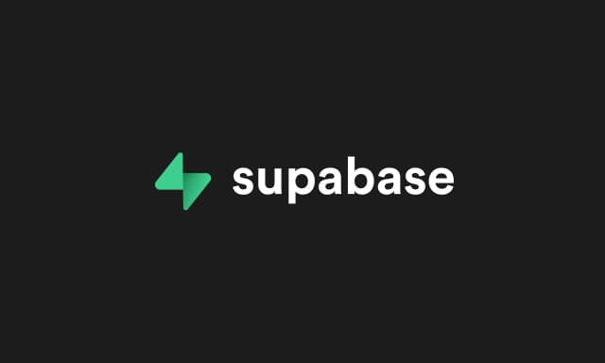
Security and Privacy: Our Top Priority
Secure Hashing
All user passwords are stored using advanced hashing algorithms, ensuring maximum security against breaches.
Environment Variable Management
Critical secrets and API keys are managed through secure environment variables, never hardcoded.
Encrypted Supabase Storage
Medical data is encrypted and securely stored within Supabase, adhering to strict data protection protocols.
No Plaintext Credentials
We guarantee that no plaintext credentials are ever stored, upholding the highest standards of data integrity.

Slide 9

Impact & Benefits: Transforming Healthcare Outcomes
Improved Preventive Care
Empowering users with personalised insights to proactively manage their health and prevent illness.
Enhanced Adherence
Reducing non-compliance with medication and appointments through intelligent reminders and support.
Early Risk Awareness
Identifying potential health risks earlier through AI-driven symptom analysis and personalised recommendations.
Accessible AI Support
Making advanced AI-powered healthcare assistance readily available to everyone, regardless of location.

Slide 10





Future Scope & SDG Alignment
Our commitment extends beyond current functionalities, aiming for continuous innovation aligned with global health goals.
Predictive Analytics
Wearable Integration
Developing capabilities for proactive health insights and risk prediction.
Seamless connectivity with wearable devices for real-time health monitoring.
Telemedicine Support
Multi-Language
Integrating virtual consultation options to enhance access to care.
Expanding language support to serve a diverse global user base.
UN SDG 3: GOOD HEALTH AND WELL-BEING

Slide 11
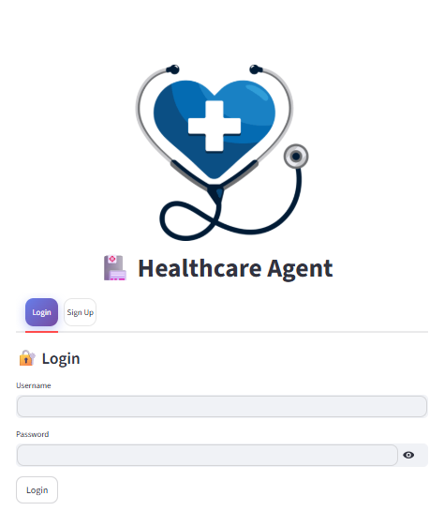
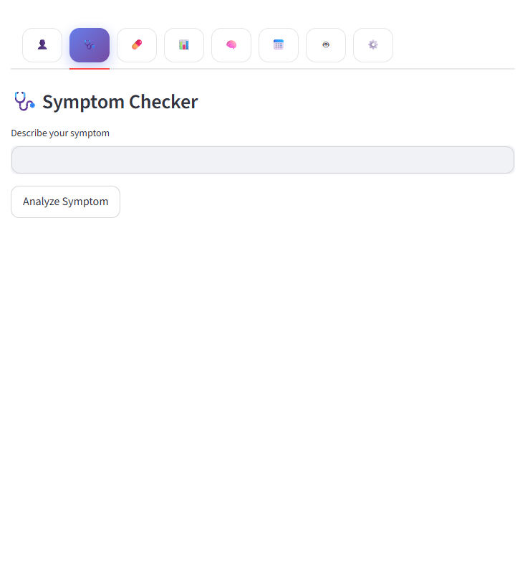
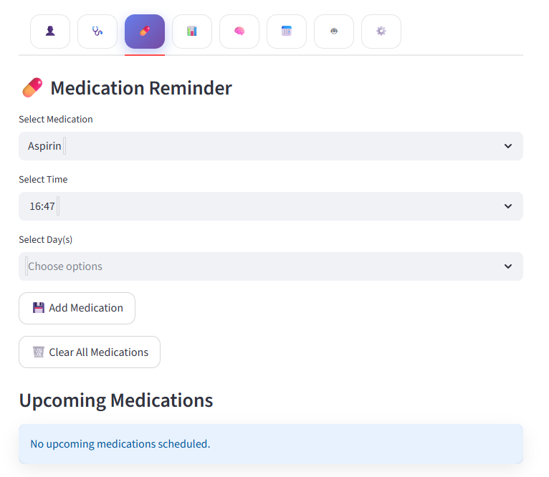
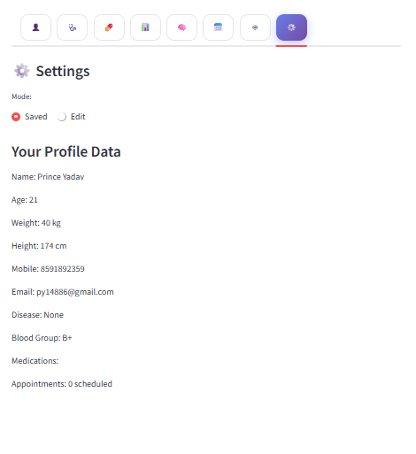
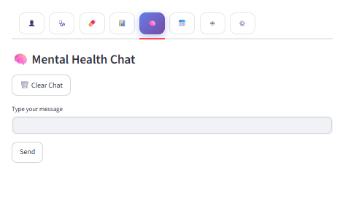
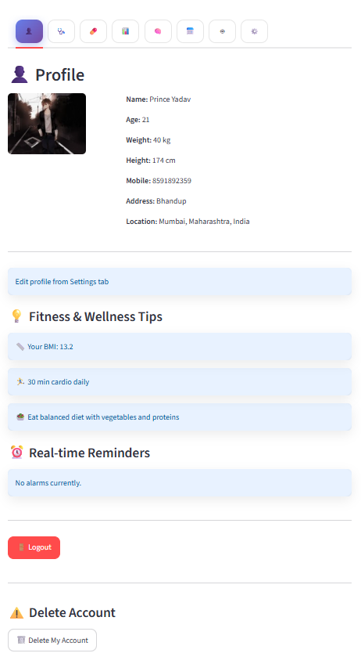
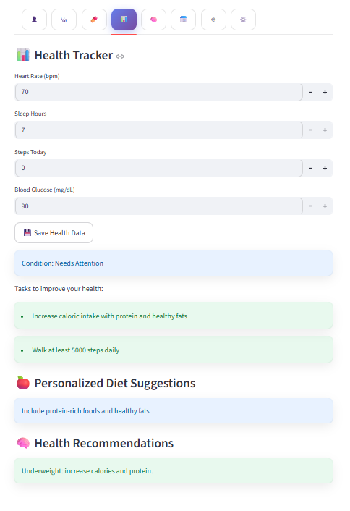
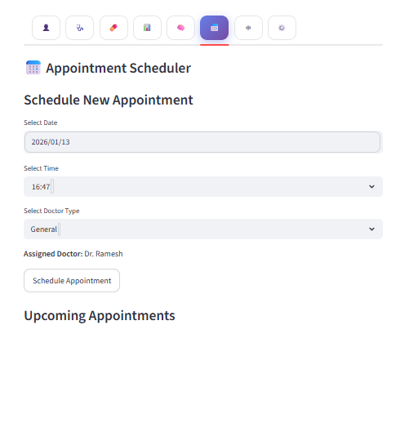
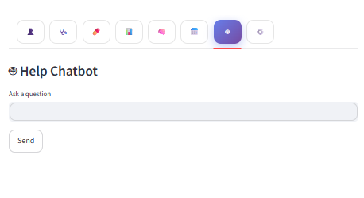
Screenshots

Slide 12
Project Details
Github Repository
https://github.com/mr-prince-yadav/Healthcare-AI-Agent-2.0
Google Drive
https://drive.google.com/drive/folders/13fcZtKK3jx96qCPn7gzoZnNzKlGBC-Jk?usp=sharing
Streamlit App
https://healthcare-ai-agent-20.streamlit.app
Render App
https://healthcare-ai-agent-2-0.onrender.com

Slide 13
THANK YOU

